Slide 1
Kubernetes on AWS &
KubeNow on AWS
Advances in Data Sciences and Architecture
Harshad Pardeshi (linkedin.com/in/harshad-pardeshi)
Prithvi Kamath (linkedin.com/in/prithviprakashkamath)
Tejesh Rathi (https://www.linkedin.com/in/tejesh-rathi)
GitHub Link: https://github.com/PrithviKamath/ADS/Kubernetes&Kubenow
Under the guidance of Professor Srikanth Krishnamurthy

Slide 2
Agenda
Kubernetes
Kubernetes on AWS
Python Application using Spark
KubeNow
KubeNow on AWS

Slide 3
Kubernetes
Kubernetes is an open-source platform for automating deployment, scaling, and operations of application containers across clusters of hosts, providing container-centric infrastructure.
Orchestration tools
Open Source
Load Balancing

Slide 4
Kubernetes on AWS
Demo

Slide 5
Python application on Spark
Demo

Slide 6
KubeNow
Simple, light-weight, stack of tool for Kubernetes provisioning, while making DevOps transparent and fun.
Developed as a part of the Phenomenal Project at Uppsala University
Thin layer on top of Terraform, Packer, Ansible and kubeadm.
Advantages:
Fast and transparent access to data/information/knowledge
Easy access to compatible tools
Simple ways to connect components into analysis workflows
Scalable analysis, should preferably only be bounded by costs
Rapid updates when new data is available or bugs are fixed

Slide 7
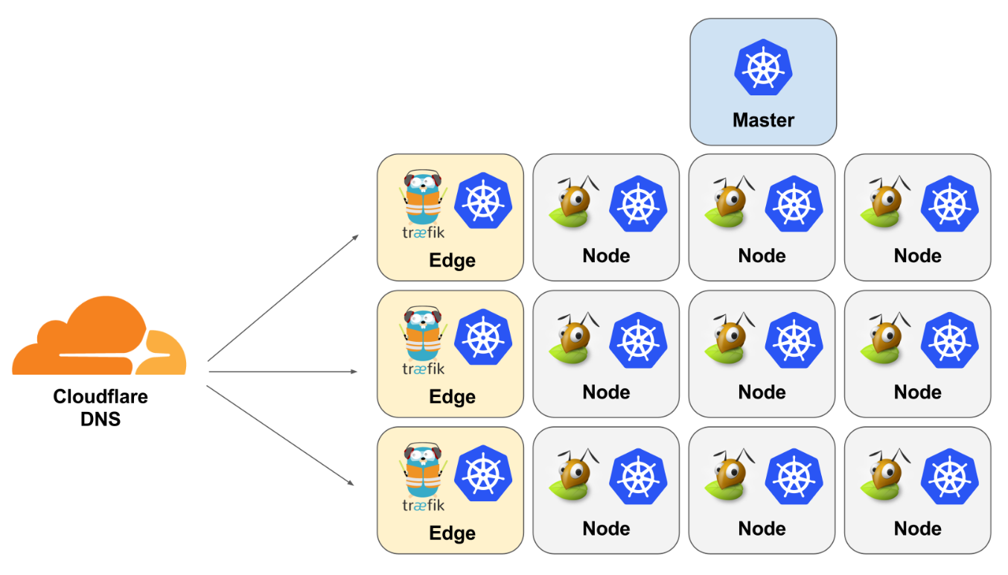
Architecture
Weave networking.
Traefik HTTP reverse proxy and load balancer
Cloudflare dynamic DNS integration
GlusterFS distributed file system

Slide 8
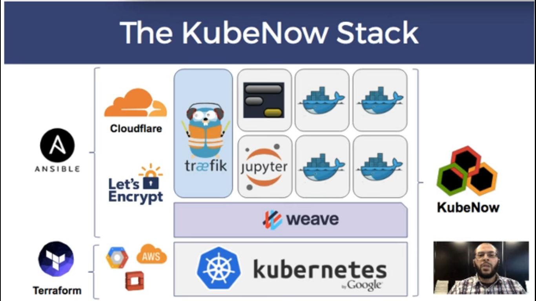
Deploy KubeNow on AWS

Slide 9
KubeNow on AWS
Demo

Slide 10
References
https://github.com/kubenow/KubeNow
http://kubenow.readthedocs.io/en/stable/
KubeNow Tutorial
Kubernetes on AWS
Spark on Kubernetes

Slide 11
Questions ?

Slide 12
Thank You…

